Slide 1
Certification Prep Course - Foundations of IBM Cloud V2
Exam C1000-083
Section 4 - IBM Cloud Services
IBM Cloud
Hybrid, multi-cloud by design.
Designed for your data.
AI Ready.
Secure to the Core.

Slide 2
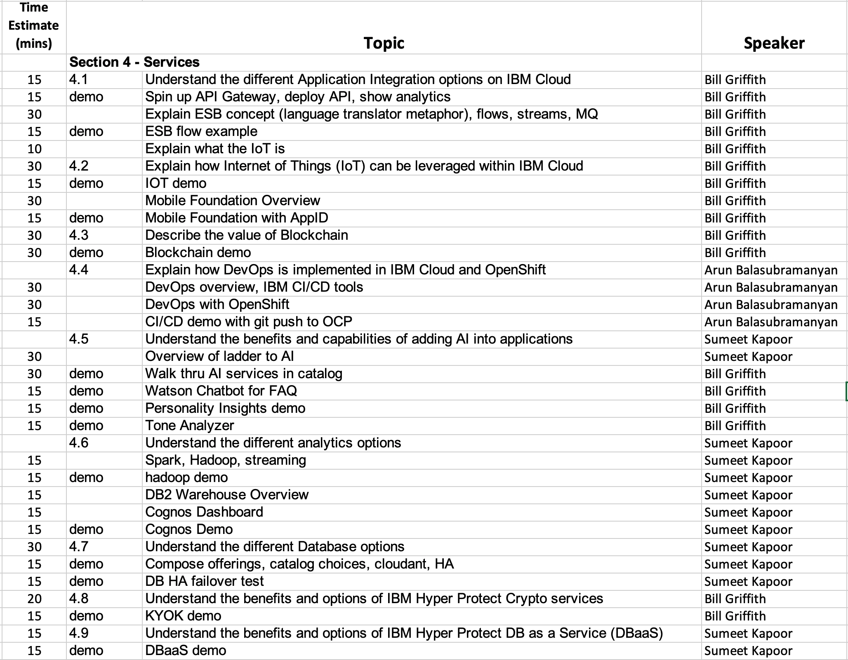
Agenda

Slide 3
Section 4.1 – Understand the different Application Integration Services on IBM Cloud
What is API Gateway
IBM® Cloud API Gateway is a free service that you can use to create, secure, share, and manage APIs that access IBM Cloud resources.
What is API Connect
IBM API Connect is a comprehensive end-to-end API lifecycle solution that enables the automated creation of APIs, simple discovery of systems of records, self-service access for internal and third party developers and built-in security and governance.
What is App Connect
IBM® App Connect in IBM Cloud is a business-friendly tool that you can use to integrate your cloud-based or on-premises applications to automate tedious and repetitive tasks.
What is Event Streams
IBM Event Streams is a high-throughput message bus built with Apache Kafka. It is optimized for event ingestion into IBM Cloud and event stream distribution between your services and applications.
What is MQ
IBM MQ is an enterprise grade messaging middleware service that gives independent and potentially non-concurrent applications secure messaging capabilities, such as point-to-point and publish/subscribe models. MQ has been proving itself as an effective messaging solution for more than 25 years. This IBM MQ on Cloud service enables you to use IBM MQ as a managed offering, therefore IBM will handle upgrades, patches and also many of the operational management tasks, allowing you to focus on the integration of MQ with your applications.
https://cloud.ibm.com/catalog?category=integration#services

Slide 4

Modernizing Integration is fundamental
To drive new customer experiences organizations must tap into an ever-growing set of applications, processes and information sources – all which significantly expand the enterprise’s need for and investment in integration capabilities.
Source: Forrester Research

Slide 5






Why is integration difficult?
Enterprise systems consist of many logical endpoints
Off-the-shelf applications, services, web apps, devices, appliances, custom built software…
Endpoints expose a set of inputs and outputs, which comprise
Protocols - e.g. MQ, TCP/IP, HTTP, File system, FTP, SMTP, POP3 etc.
Message Formats - e.g. Binary (C/COBOL), XML, Industry (SWIFT, EDI, HL7), User-defined
Integration is about connecting these endpoints together in meaningful ways
Route, Transform, Enrich, Filter, Monitor, Distribute, Decompose, Correlate, Fire and Forget, Request/Reply, Publish/Subscribe, Aggregation, Fan-in, Complex Event Processing…
Notes:
Three strands are involved in connecting applications together.
Applications need to talk with each other over a communications protocol. Typical protocols in use today include TCP/IP, and higher level protocols such as FTP, SMTP and HTTP.
Over the communications protocol applications exchange data, typically in discrete structures known as messages. The format of these messages can be defined from C structures or COBOL copybooks (for example), or simply use a standard format such as XML.
In order to connect applications together so that their protocols and message formats interoperate, mediation patterns need to be applied to one or both systems you’re trying to connect. These mediation patterns can be relatively straightforward, e.g. routing messages from one place to another, or the transformation of one message format into another… to relatively complex patterns such as aggregating multiple outputs from an application into a single message for a target system.

Slide 6
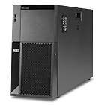


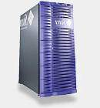
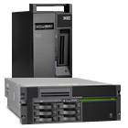
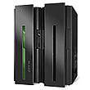
Hybrid integration quickly becomes unscalable
Partners
Billing
Web Site
soap/http
JMS
JDBC
Flat Files
N*(N-1)
WebSphere MQ
ERP
CRM
CICS
By 2020, 70% of organizations will have more than 1000 distinct applications and 30% more than 2500. (IDC, January 2015)
Notes:
6
Math: P2P = n * (n-1) vs ESB = 2N+1… e.g. 6 above = 30 integrations via P2P vs 13 … typical bank has 300 back office = ~90K integrations IF all systems need to talk to all others
Main Point An ESB provides the integration layer to connect you IT systems and provide services,
Many SOA connectivity implementation efforts leverage a Enterprise Service Bus. The ESB can help you achieve the goal of SOA – in fact the ESB is widely accepted as a key element at the heart of every successful SOA.
The ESB is a flexible connectivity infrastructure for integrating applications and services. While there is no broad agreement on all of the capabilities which can comprise an ESB, this basic definition is generally accepted by leading analysts and vendors. For example, Roy Shulte of Gartner Group describes an ESB as “A lightweight connectivity infrastructure built using JMS, XML, and Web Services standards.”
An ESB does five basic things:
It CONNECTS everything to everything
It MATCHES & ROUTES communications between services
It CONVERTS between different transport protocols
It TRANSFORMS between different data formats
And It DISTRIBUTES business events
The combination of any or all of these functions allows the rest of the IT infrastructure to be simplified, increasing both reliability and reuse, and offering the opportunity for long lasting cost savings

Slide 7

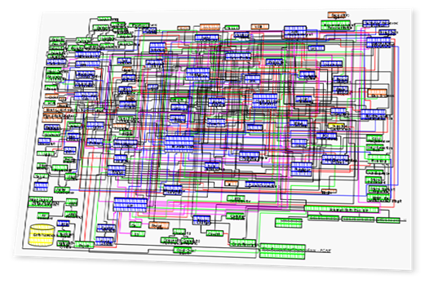
Integration done incorrectly inhibits agility, growth, innovation
Business
Objectives
Top line growth
Operational Excellence
Reduce costs
Gain market share
Innovation
Complex processes & systems
Complex applications & interfaces
Difficult to adapt quickly
Large portion of IT budget spent on maintenance, not on new value add investments
Resources and IT Assets
Legacy Claims Database
Auto
Claims System
Home Claims System
Life Insurance Claims
Business Partner Claims System
…
Notes:
Main points:
Connectivity between your applications is what powers your business – very easy to get bogged down.
SOA can help to point your business where you want to be – but fundamental to the success of SOA is the improvement of connectivity throughout the business. (i.e. Decoupling the links between applications, systems and services)

Slide 8
Solution: Hybrid Integration Platform
Web Portal
Partners
Backends
2N+1
Integration Layer
Results:
Maintenance costs goes down
Flexibility goes up
Scalability of new end points goes up
Notes:
8
Main Point An ESB provides the integration layer to connect you IT systems and provide services,
Many SOA connectivity implementation efforts leverage a Enterprise Service Bus. The ESB can help you achieve the goal of SOA – in fact the ESB is widely accepted as a key element at the heart of every successful SOA.
The ESB is a flexible connectivity infrastructure for integrating applications and services. While there is no broad agreement on all of the capabilities which can comprise an ESB, this basic definition is generally accepted by leading analysts and vendors. For example, Roy Shulte of Gartner Group describes an ESB as “A lightweight connectivity infrastructure built using JMS, XML, and Web Services standards.”
An ESB does five basic things:
It CONNECTS everything to everything
It MATCHES & ROUTES communications between services
It CONVERTS between different transport protocols
It TRANSFORMS between different data formats
And It DISTRIBUTES business events
The combination of any or all of these functions allows the rest of the IT infrastructure to be simplified, increasing both reliability and reuse, and offering the opportunity for long lasting cost savings

Slide 9
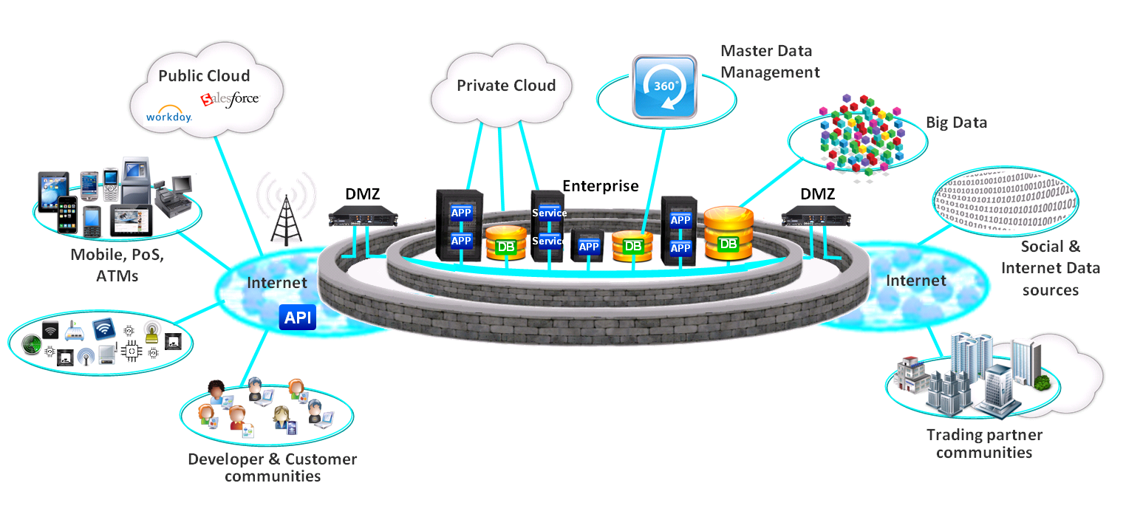
Deliver fast, flexible and reliable access to data, applications and information regardless of platform, device, or data formats
Hybrid Clouds require Hybrid Integration Platforms
IBM Hybrid Integration
IBM App Connect for cloud service integration
IBM Event Streams for high volume messaging bus
IBM App Connect the ESB integration backbone
IBM API Management for API management
WebSphere MQ for guaranteed messaging backbone
IBM API Gateway for security and integration gateway
Notes:
As your IT systems evolve, new standards come out like REST or JSON that the original application wasn’t designed for. So you can rip-open that old application and write some code for these new standards, OR you can use middleware that has adapters and connectors to convert in real-time the data from your existing systems into formats that other systems need. Furthermore, by canonicalization these “integrations” you achieve far greater reusability reducing time and cost.

Slide 10






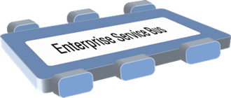













The Enterprise Service Bus Pattern
An Enterprise Service Bus (ESB) is a flexible connectivity infrastructure for integrating applications and services.
An ESB performs the following between requestor and service
VIRTUALIZES
location and identity of services
MATCHES & ROUTES communications between services
CONVERTS between different transport protocols
TRANSFORMS between different data formats
Shape = Transport protocol
Color = Data format
Notes:
The Enterprise Service Bus (ESB) can help you achieve the goal of SOA – in fact the ESB widely accepted as key element at the heart of every successful SOA.
The ESB is a flexible connectivity infrastructure for integrating applications and services. While there is no broad agreement on all of the capabilities which can comprise an ESB, this basic definition is generally accepted by leading analysts and vendors. For example, Roy Shulte of Gartner Group describes an ESB as “A lightweight connectivity infrastructure built using JMS, XML, and Web Services standards.”
The ESB does four basic things:
It MATCHES & ROUTES communications between services
It CONVERTS between different transport protocols
It TRANSFORMS between different data formats
It IDENTIFIES & DISTRIBUTES business events
The flexibility and “service virtualization” provided by the ESB is achieved through what architects call “separation of concerns” – the clear separation between the applications which run the business (including business services and business processes) and the ESB (the infrastructure for connecting applications and services together). This flexibility enables IT change with very limited impact – such as the update or replacement of a given business service, or the development of a new composite solution which leverages existing services. That is the power of the ESB – enabling you to realize the full value of SOA.

Slide 11
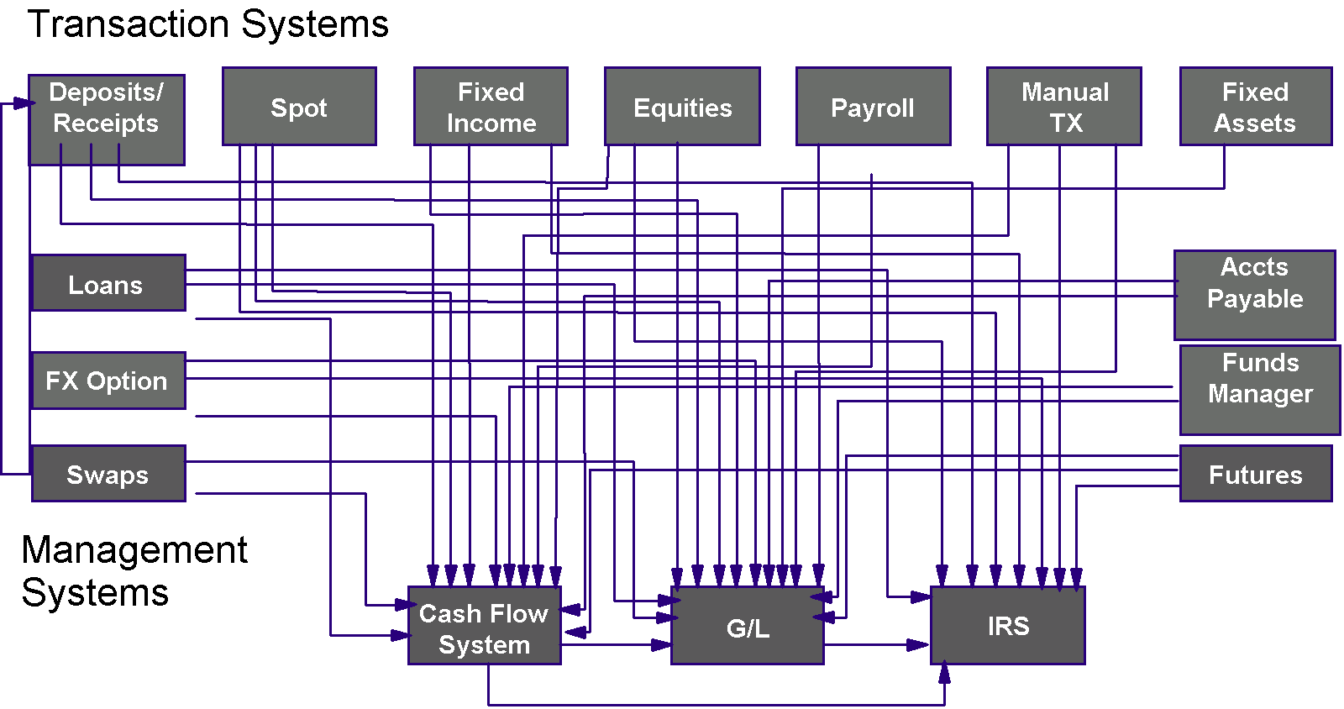
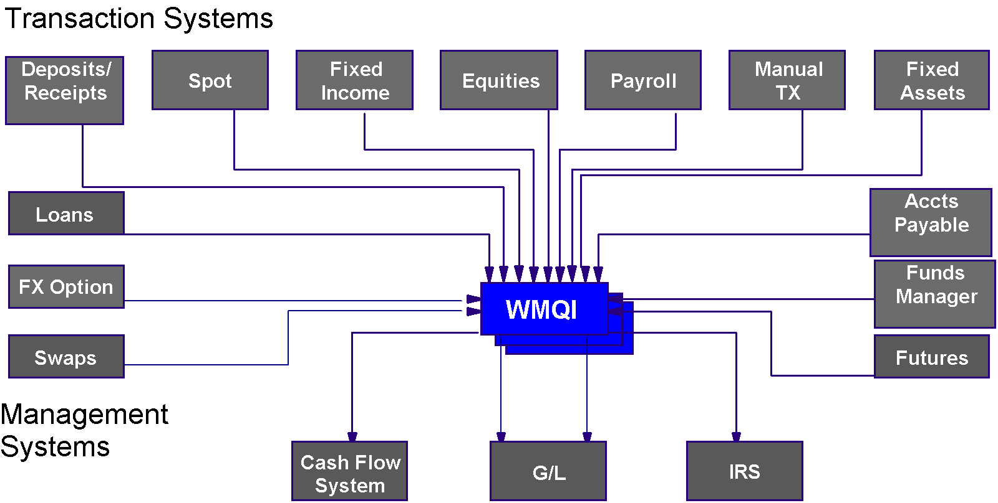
An ESB is a scalable integration architecture
{Name, Stock, Quantity, Price, Date}
Gordon Gekko,ABC Toys,42,1.50,060508
IBM App Connect
Gordon Gekko#ABC Toys#42#1,05#050608
Notes:
Let's now discuss what an integration solution should deliver in terms of a concrete scenario to help understand exactly which problems such a product can be used to address.
Application A sends some data to application B. At design time, the two applications agreed on the format of the data as the ordered set {Trader Name, Stock, Qty, Price, Date}. Further, the date is in US format, the price in US dollars, and the data is delimited using commas.
Sometime later, Application C is introduced. It needs the same data, but because it is a packaged application from a vendor or maybe an application that already existed, it expects data to arrive in a different format. The date is in UK format, the price is in pounds sterling and the data is delimited by a hash (#). So, we now have an integration choice to make. Either application C must be enhanced to support the data format between A and B, or application A must be enhanced to support a second data format for application C. With only three applications this is not an horrendous scenario. But over time, as more applications are introduced, or existing applications are changed, more and more interfaces are required just to deal with the multiple data formats. The number of interfaces required and the cost to implement and test the changes grows exponentially and very quickly gets out of hand.
In the Industry this situation is routinely called the "spaghetti syndrome". It is characterized by application specific interfaces and hard wired routing between applications. This is complicated, expensive, inflexible and unresponsive. The solution is the use of a message broker. With this approach the broker sits in the middle of the applications and each application is interfaced once to the broker. This can be done non-invasively through the use of an adapter. The message broker then handles the task of talking to the destination application by transforming the message to its required format and routing it. Introducing a message broker means that applications can easily be added or changed in isolation. Moreover, the complexity of data formats and logical connectivity is removed from the application, leaving it to focus on providing business value. This so called "Hub and Spoke" architecture provides true flexibility in application design, allowing new and valuable applications to be created by integrating existing applications without change.

Slide 12
Section 4.1.1.2 – Understand when to use API Gateway
What’s wrong with this picture?
Product Detail Microservice
www
Runtime (Node.js, WAS, etc.)
Systems of Record
Traditional Business
Integration Tier
These Microservices are exposed to the open web!
What if the Product Detail microservice sees a huge spike in traffic? It could bring down the SoR’s, preventing order taking, shipping, etc, and risking the traditional business!
Orders Microservice
Orders data
Product data
Runtime (Node.js, WAS, etc.)
Firewall

Slide 13
Section 4.1.1.2 – API Gateway Demo
https://www.ibm.com/support/knowledgecenter/SSMNED_2018/com.ibm.apic.apionprem.doc/tutorial_apionprem_apiproxy.html
https://cloud.ibm.com/docs/tutorials?topic=solution-tutorials-serverless-api-webapp#serverless-api-webapp

Slide 14
Section 4.1.1.2 – Understand when to use API Gateway
API Gateway
(rate limiting, security)
Product Detail Microservice
www
Runtime (Node.js, WAS, etc.)
API
Systems of Record
Traditional Business
Integration Tier
You AT LEAST need:
Rate limiting
Security
…an API Gateway
NOTE: Firewall could be internet-facing or between internal networks
API
Orders Microservice
Orders data
Product data
Runtime (Node.js, WAS, etc.)
Firewall
https://cloud.ibm.com/docs/api-gateway?topic=api-gateway-getting-started

Slide 15
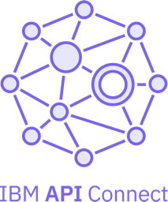
Section 4.1.1.1 – Understand when to use API Connect
What is IBM API Connect?
Create
Automatically create and test APIs to expose data, microservices, enterprise applications and SaaS services.
Secure
Easily apply built-in and extensible policies to secure, control and mediate the delivery of APIs with unmatched scale.
The Scalable Multi-Cloud API Platform
A complete, modern and intuitive API lifecycle platform to create, securely expose and manage APIs across clouds to power digital applications
Manage
Rapidly publish, lifecycle govern, socialize, analyze, monitor and monetize APIs with built-in capabilities.
https://cloud.ibm.com/docs/apiconnect?topic=apiconnect-getting-started

Slide 16
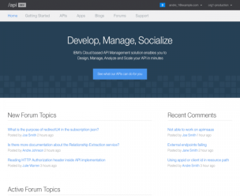
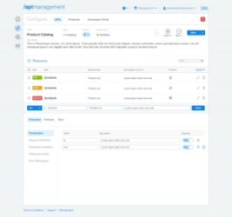
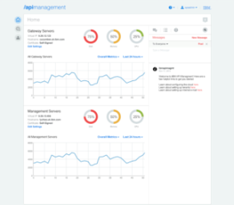




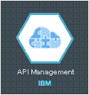
IBM API Connect
Easily manage your APIs, on premise or in the cloud.
Developer Portal
API Manager
Management Console
Welcome to the API Portal
Explore API documentation
Provision application keys
Self-service social experience
Define and manage APIs
Explore API usage with analytics
Manage API user communities
Provision system resources
Monitor runtime health
Scale the environment
On-premise
private
Off-premise
SaaS
API Gateway
(IBM DataPower)
Off-premise
dedicated
IBM Cloud
Enforce runtime policies to control API traffic
Notes:
{DESCRIPTION}
This slide contains a graphic that is covered by the narration written in the transcription of this slide.
REST and SOAP APIs
{TRANSCRIPT}
The IBM API Management is a single comprehensive solution to design, secure, control, published, monitor and manage an enterprise’s APIs. There are two key layers to the IBM API Management solution: the management layer, IBM API Management and the API gateway layer, IBM DataPower. Although the API Management solution is relatively young, the strength of this solution is IBM DataPower - the highly secure, highly scalable appliance. The API Management solution supports IBM DataPower in both physical and virtual form factors. See the latest hardware requirements to understand the supported minimum firmware levels for DataPower. IBM API Management on the other hand is only available in a virtual form factor supported on VMware, Zen and PureApplication System at the time of this recording. Altogether, IBM API Management solutions is a fully on premise, multitenant solution for API providers.

Slide 17
API Connect: Components & Personas
2
Developer Portal
How App Developers find, subscribe, analyze APIs
Shavon
API Developer
Steve
API Product Manager
Will
API Operations
Andre
App Developer
subscribe
use
4
API Toolkit
How API Developers create & test APIs
develop
3
API Manager
How API owners manage APIs
Analytics
Make better decisions
Shavon
API Developer
develop
Application User
use
Application
1
API Gateway
Enforces API Security, Traffic Management, Mediation policies at runtime
Target Endpoint
The “brains” of the API or Microservice, performs the business logic

Slide 18
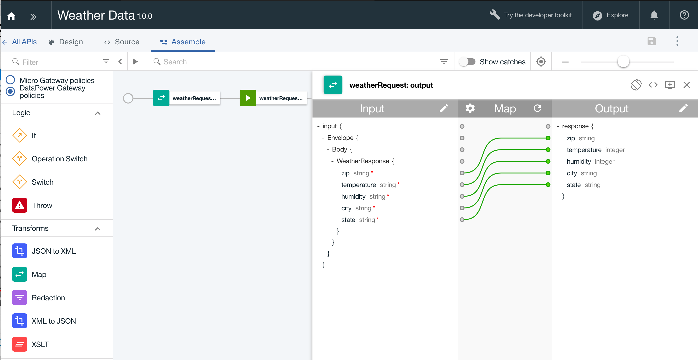
Section 4.1.1.1 – API Connect Demo
https://cloud.ibm.com/docs/apiconnect/tutorials?topic=apiconnect-tut_expose_soap_service

Slide 19



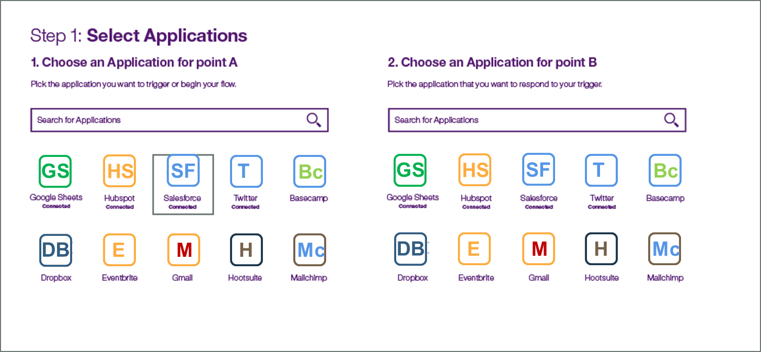
Section 4.1.2.1 – Understand when to use APP Connect
IBM® App Connect in IBM Cloud is a business-friendly tool that you can use to integrate your cloud-based or on-premises applications to automate tedious and repetitive tasks.
Connect your apps in minutes, on cloud or local, with no code needed
SaaS solution for the business users
Built in extensions to IBM Integration Bus
AppConnect
19
https://cloud.ibm.com/docs/services/AppConnect?topic=AppConnect-concepts#appconnect

Slide 20
IBM App Connect Concepts
Flows - You create flows in IBM® App Connect to connect your applications so that something that happens in one application makes something else happen in another application. You can create event-driven flows and flows for APIs.
Event-driven flows – event occurs kicking off “integration logic” flow
API driven flows – flow exposed as an API that is invoked by a requestor
Applications - When you create event-driven flows or flows for APIs, applications are the cloud-based software applications that you're connecting.
Actions – The “function” to perform in the flow, such as create, retrieve, and update or delete (CRUD).
Data Mapping – Sometimes the input data needs to be converted and “mapped” to the output data. A data mapping is the process of mapping one data structure into another.
https://cloud.ibm.com/docs/services/AppConnect?topic=AppConnect-concepts

Slide 21
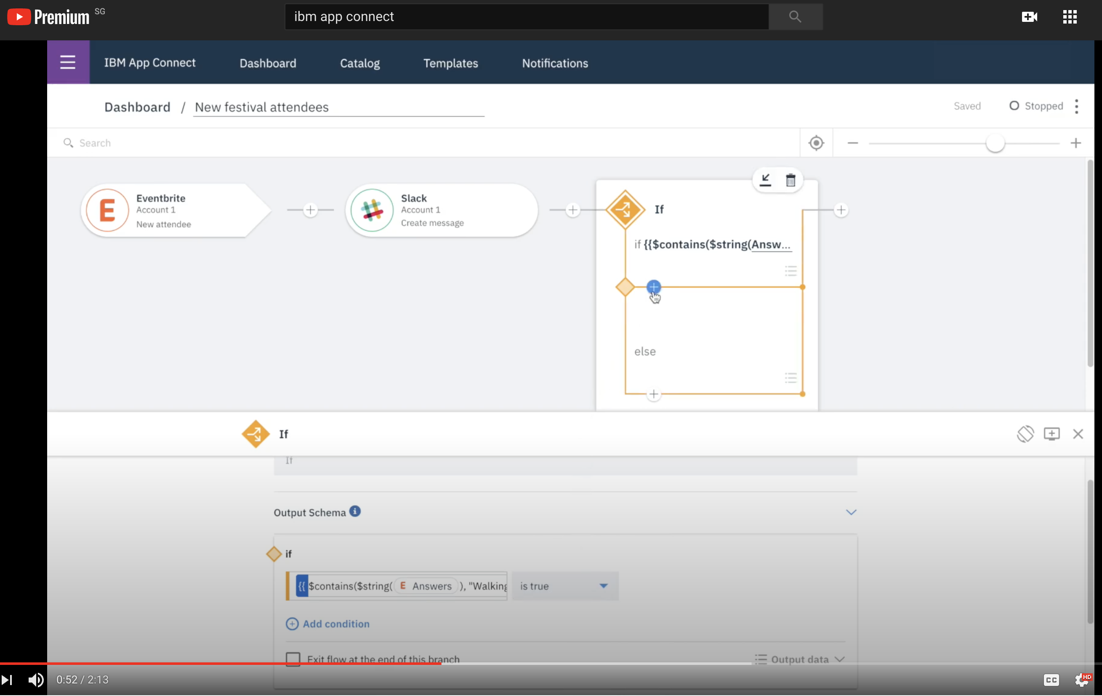
Section 4.1.2.1 – APP Connect Demo
https://www.youtube.com/watch?v=xa-65X2RZuE

Slide 22
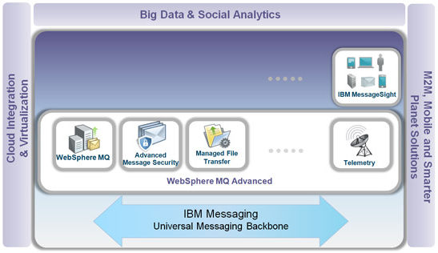
Section 4.1.2.3 – Understand when to use MQ
IBM® MQ is robust messaging middleware that simplifies and accelerates the integration of diverse applications and business data across multiple platforms. IBM MQ facilitates the assured, secure and reliable exchange of information between applications, systems, services and file by sending and receiving message data via messaging queues, thereby simplifying the creation and maintenance of business applications. It delivers Universal Messaging with a broad set of offerings to meet enterprise-wide messaging needs, as well as connectivity for the internet of things and mobile devices.
IBM MQ provides the universal messaging backbone for service-oriented architecture (SOA) connectivity. It connects virtually any commercial IT system, with support for more than 80 platforms.
To enable businesses to connect all their assets, IBM MQ includes:
IBM MQ to provide enterprise messaging; the core function of the IBM MQ family.
Advanced Message Security to protect the security of messages from application to application, without needing to change the application code itself.
Managed File Transfer to enable customers to move their business data stored in files over the IBM MQ infrastructure.
Telemetry to extend the universal messaging backbone with the MQTT protocol to a wide range of remote devices.
https://cloud.ibm.com/docs/services/mqcloud?topic=mqcloud-mqoc_new_to_mq

Slide 23




How does WebSphere MQ work?
Messaging services are based on Queues that store and forward data based on simple programming commands or determined dynamically
Uses the proven database technique of two-phase commit transactions to ensure messages are not lost or duplicated
Uses publish/subscribe to route messages dynamically based just on keywords or “topics”
Uses multi-processor threading and clustering to accelerate throughput of messages
Message
Queue
Application A
Application Z
MQ Client
MQ Server
Notes:
Key Takeaways:
This chart is self-explanatory.

Slide 24

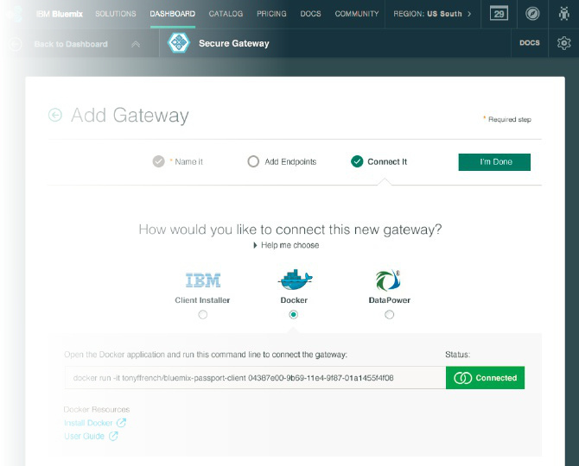

Connect Clouds Securely Together
Secure Gateway - creating a hybrid connection to your on-premises data
Connect
IBM Secure Gateway: Provides secure connectivity from Bluemix to other applications and data sources running on-premise, or in other clouds.
What’s unique?
Unique passport feature allows for single step download, install, and secure setup of client
Flexible Gateway topology allows segregation, Load Balancing, and Fault tolerance
Layered security on the cloud side and client side
API / SDK for secure connect directly from app
Notes:
Intergration

Slide 25


Section 4.1.2.2 – Understand when to use Event Streams
IBM® Event Streams for IBM Cloud™ is a high-throughput message bus built with Apache Kafka. It is optimized for event ingestion into IBM Cloud and event stream distribution between your services and applications.
Send push notifications
Transactions
Alerts
_{IBM MQ}
IBM MQ connects mission-critical Systems of Record, requiring transactional, once-only delivery E.g. payment transactions
IBM Event Streams distributes and processes streams of events in real-time to intelligently engage with customers E.g. alerts on spending patterns
https://cloud.ibm.com/docs/EventStreams?topic=EventStreams-about

Slide 26



Key usage patterns Provide data to applications while protecting your backend
IBM Event Streams allows you to emit streams of data from a mainframe system, providing a high speed decoupled buffer – allowing many readers to absorb the data
Allows microservices to be developed, acting against the stream with no impact on critical systems of record
Systems of Record
IBM Event Streams
Protected
Scalable, High speed
Multiple readers
Expand to multi-cloud
Expand the pattern to multi-cloud – Event streams can be used to create a local buffer of data in each cloud environment
Minimize on-prem to cloud data transfer
Give the fastest response for cloud applications
https://www.youtube.com/watch?v=XyNy7TcfJOc
Notes:
3 typical usage patterns/starting points over 3 charts across simple cases at the top of each chart then moving down takes each forward to the next level.
Top:
One of the most common usage patterns for Kafka/Event Streams. Multiple Innovation/Application/Microservice teams are demanding data from the systems of record, often hosted on IBM z. The teams running the systems of record need to ensure that they are stable, but this new demand is unpredictable, and often not well defined at the outset. Kafka/Event Streams offers a way to expose the data so that it can be consumed by multiple readers at their own pace. The load on the backend systems is well defined and predicable.
Kafka offers the data as a persistent read-only buffer or cache of the data which is continually refreshed and updated.
Example customers include JPMC and M&S who have followed this pattern.
Progress that scenario to the next level by pushing that data out to multiple consumers on multiple clouds. Allowing each set of consumers on each cloud to have it’s own buffer or stream of the data allows them to have a consistent, rapid read of the data, whilst minimising the amount of data transferred.
Maersk are taking this approach.

Slide 27
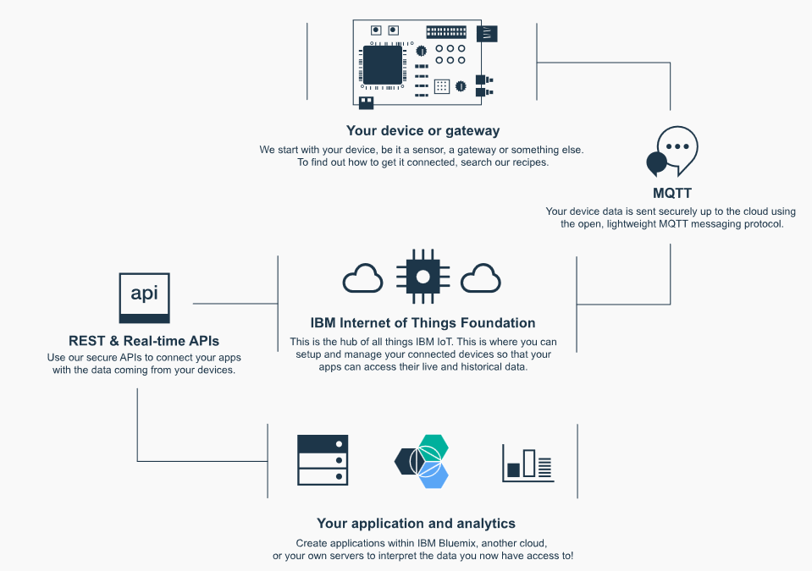
Section 4.2 – Explain Internet of Things (IoT) on the IBM Cloud
IBM IoT Platform - IBM Watson™ IoT Platform is a fully managed, cloud-hosted service that makes it simple to derive value from Internet of Things (IoT) devices.
https://cloud.ibm.com/catalog/services/internet-of-things-platform#about

Slide 28
Section 4.2 –Internet of Things (IoT) on the IBM Cloud Exercise
https://developer.ibm.com/recipes/tutorials/raspberry-pi-4/

Slide 29
Section 4.2.3 – List and describe the features provided by IBM Mobile Foundation
What is IBM Mobile Foundation - IBM Mobile Foundation is an integrated platform that helps you extend your business to mobile devices. Mobile Foundation includes a comprehensive development environment, mobile-optimized runtime middleware, a private enterprise application store, and an integrated management and analytics console, all supported by various security mechanisms.
Quality Assured
Hyper-Contextual
Enable total app quality management
Incorporate intelligent context and insight
Rapid development
Simply Cognitive
Essential backend services for your app pre-integrated with advanced safeguards, management and analytics
Ideate and prototype your app with no code, use a low-code approach to build
Embed human intuition and expertise and have intelligent dialogs
https://cloud.ibm.com/docs/services/mobilefoundation?topic=mobilefoundation-configure_push_notifications

Slide 30
Section 4.2.4 – Distinguish the features of Push Notifications vs. Mobile Foundation
IBM Push Notifications - IBM Cloud Push Notifications is a service with which you can use to send notifications to mobile devices and browsers. Notifications can be targeted to all application users or to a specific set of users and devices that use tags. For every message that you submit to the service, the intended audience receives a notification. Push Notifications is a public, shared multi-tenant service on IBM Cloud. Push Notifications service is accessed through public endpoints. Both the control and data plane of the service are shared across tenants.
30
https://cloud.ibm.com/docs/services/mobilepush?topic=mobile-pushnotification-gettingstartedtemplate
Notes:
Speaking Points:
Almost all new development is around mobile.
Too many of us are still writing to low level of SDKs – iOS8, iOS9, 200 variations of Android, etc. – and you have to address them all because you have to support what end users are using.
You need to be able to build in context and personalize the interaction to the specific user with the data and insights that are relevant to them.

Slide 31
Section 4.2.5 – Describe the use of AppID for mobile development
IBM AppID - Use App ID to add authentication to your mobile and web apps and protect your APIs and back-ends running anywhere. No code change or redeploy is required for your containerised apps. Add email/password based sign-up and sign-in, and MFA with App ID's scalable user registry - Cloud Directory, or social log-in with Google or Facebook. For employee apps, use SAML 2.0 federation to let users sign-in with their enterprise credentials. For all app users, enrich their profiles with additional info so you can build engaging experiences.
31
https://cloud.ibm.com/docs/services/appid?topic=appid-about
Notes:
Speaking Points:
Almost all new development is around mobile.
Too many of us are still writing to low level of SDKs – iOS8, iOS9, 200 variations of Android, etc. – and you have to address them all because you have to support what end users are using.
You need to be able to build in context and personalize the interaction to the specific user with the data and insights that are relevant to them.

Slide 32
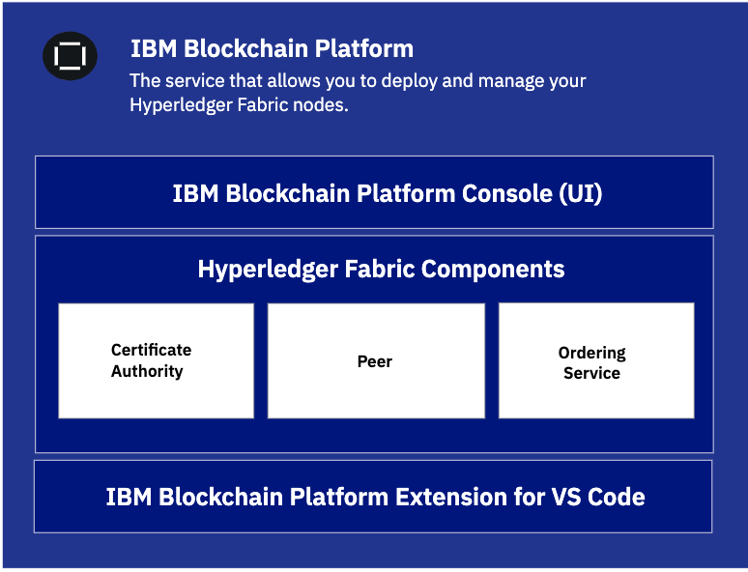
Section 4.3 – Explain the business value of blockchain
What is IBM Blockchain Platform - Blockchain is a shared, immutable ledger that facilitates the process of recording transactions and tracking assets in a business network. An asset can be tangible (a house, a car, cash, land) or intangible (intellectual property, patents, copyrights, branding). Virtually anything of value can be tracked and traded on a blockchain network, reducing risk and cutting costs for all involved.
Distributed ledger - All network participants have access to the distributed ledger and its immutable record of transactions. With this shared ledger, transactions are recorded only once, eliminating the duplication of effort that’s typical of traditional business networks.
Records are immutable - No participant can change or tamper with a transaction after it’s been recorded to the shared ledger. If a transaction record includes an error, a new transaction must be added to reverse the error, and both transactions are then visible.
Smart contracts - To speed transactions, a set of rules – called a smart contract – is stored on the blockchain and executed automatically. A smart contract can define conditions for corporate bond transfers, include terms for travel insurance to be paid and much more.
https://cloud.ibm.com/docs/blockchain?topic=blockchain-blockchain-component-overview

Slide 33
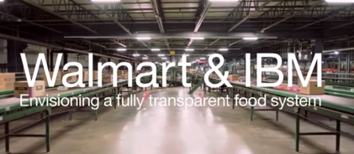
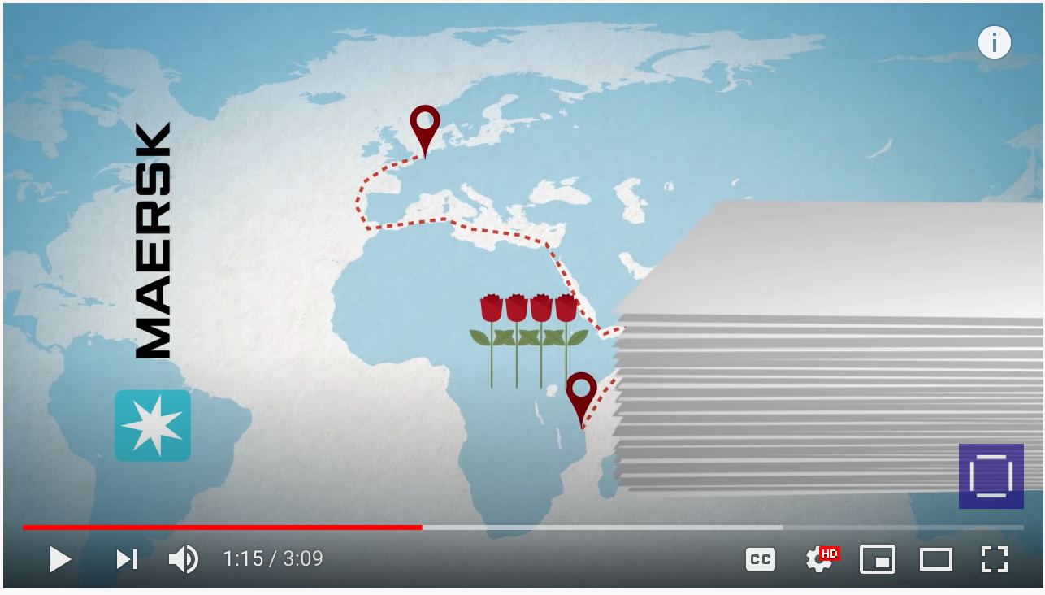
Section 4.3 – Explain the business value of blockchain
600 million people fall ill annually as a result of contaminated food. 420,000 die as a result.
$55B - $93B annual economic impact
Pre-blockchain solution took 6 days, 18 hours, 26 minutes to trace a package of sliced mangoes back to their source. IBM Blockchain solution took 2.2 seconds.
http://y2u.be/SV0KXBxSoio
Track millions of shipping container journeys per year
Shipping a single shipping container requires ~200 documents
Could increase WW GDP by 5% and total trade volume by 15%
http://y2u.be/tdhpYQCWnCw
Finds IBM chosen as the got-to company for Blockchain deployment by 65% of respondents.
IBM ranked 9X higher than Microsoft
https://www.juniperresearch.com/press/press-releases/nearly-two-thirds-large-enterprises-blockchain

Slide 34
Section 4.4 – Explain how DevOps is implemented in IBM Cloud and OpenShift
What is DevOps
Benefits of IBM DevOps
Delineate between Continuous Integration (CI), Continuous Delivery (CD), and Continuous Deployment.
Understand IBM toolchains to support different application scenarios:
Canary Testing
Different Kubernetes applications
Kubernetes vs. Cloud Foundry
IBM Cloud Continuous Delivery
Understand Red Hat OpenShift DevOps stages
https://www.ibm.com/cloud/garage/toolchains/

Slide 35
Section 4.5 – Understand benefits of adding AI to applications
What is Data Science
Data science is the process of using algorithms, methods, and systems to extract knowledge and insights from structured and unstructured data. It uses analytics and machine learning to help users make predictions, enhance optimization, and improve operations and decision making.
What is Machine Learning
Machine learning is a form of AI that enables a system to learn from data rather than through explicit programming. However, machine learning is not a simple process. As the algorithms ingest training data, it is then possible to produce more precise models based on that data. A machine-learning model is the output generated when you train your machine-learning algorithm with data. After training, when you provide a model with an input, you will be given an output. For example, a predictive algorithm will create a predictive model. Then, when you provide the predictive model with data, you will receive a prediction based on the data that trained the model.
Understand IBM ML/Knowledge Management services
Watson Studio
Watson Discovery
Watson Knowledge Catalog
Watson Knowledge Studio
Watson Machine Learning
Watson Natural Language Classifier
Watson OpenScale
Understand pre-trained Watson services
Speech-to-text, text-to-speech, language-translator, personality insights, tone-analyzer
https://www.ibm.com/analytics/data-science

Slide 36

Terminology
Cognition: Cognition is the process of acquiring, learning, and understanding through various senses of human perceptions.(1)
Cognitive Computing: Man & Machine (Augmented Intelligence)
Artificial Intelligence (AI): “the science and engineering of making intelligent machines.” – John McCarthy 1956. Said another way: AI is the simulation of human intelligence processes by machines. (2)
Machine Learning (ML): Machine learning is the science and art of programming computers so that they can learn from data. (1)
Cognitive Computing
Artificial Intelligence
Machine Learning
Notes:
Key point: Man & Machine is our goal. We are not trying to replace man with Super Intelligence. There is so much work to be done with just augmenting man’s natural abilities with things that machines can now do. This is the beginning of the Cognitive Era where machines can assist us in more cognitive ways than the physical ways of the past.
Sources:
[1] - https://www.ibm.com/devops/method/content/code/practice-cognitive-101
[2] - http://searchcio.techtar
John McCarthy father of AI: http://www.artificial-solutions.com/blog/homage-to-john-mccarthy-the-father-of-artificial-intelligence
get.com/definition/AI

Slide 37
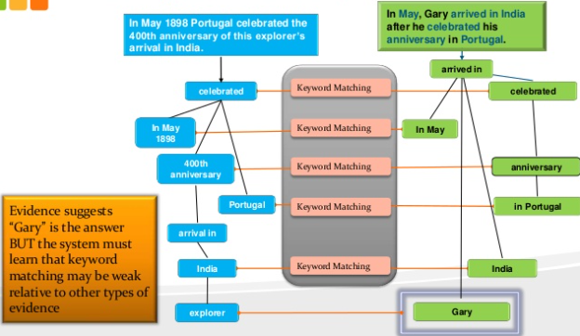
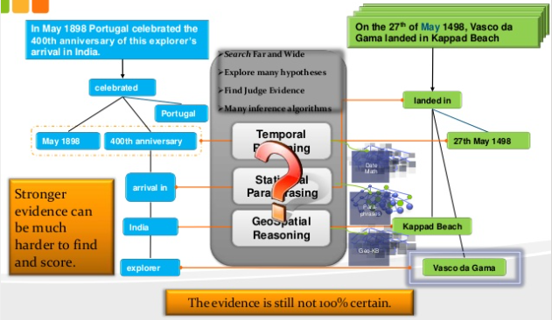
Why is human language understanding difficult
https://www.youtube.com/watch?v=BflW1hQ4RwE
Ambiguity (e.g. I shot an elephant in my pajamas.)
Idioms (e.g. You can feel blue because it is raining cats and dogs.)
Implicit (e.g. Heroes & villains abound! Colby, Coach & Rupert doth return to the fray but Boston Rob, The Tribe hath spoken. What is Survivor.)
Slang (e.g. Where the rubber meets the road.)
Errors (e.g. I use mjine for reading. Were on the way.)
Watson uses hundreds of algorithms to sort thru this ambiguity and language nuance to really understand what was asked, unlike keyword searching that is just string comparing.
Notes:
How do you know the elephant isn’t wearing the pajamas in the statement above? It is possible, but you have been trained that most of the time, people wear pajamas not animals. Watson works the same way: with enough examples, Watson can associate words together.
Tip: encourage users to search favorite web site for “news excluding celebrities”. Did the search engine “understand” the query?
Explain how keyword matching in the diagram would not return the matching answer even though 5 keywords match. The correct answer had no matching keywords. IBM Watson had to use multiple AI approaches, then rank the evidence and decide which answer had the highest probability of being correct from the past training Watson had been given.

Slide 38
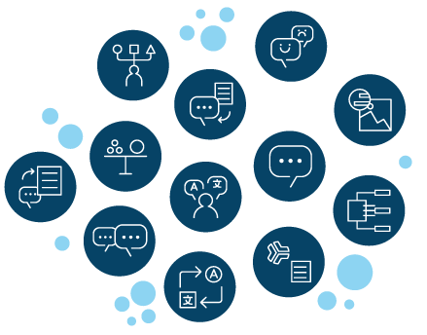

Why Now?
Big Data
2.5 Petabytes of data daily
44 Zetabytes by 2020
1.3 trillion photos in 2017
CPU/GPU Performance
IBM sets record for AI training in 7 hrs vs 10 days
Cloud
Economies of scale.
The API Economy
Notes:
Why now? Because we now have enough data to train the neural nets that typically require millions of examples to be accurate enough for practical usage (note: IBM has already trained Watson on millions of examples, so customers only need hundreds to thousands of custom examples to enhance the training). Additionally, AI takes a lot of computing power and even with the power of modern CPU/GPUs it takes Microsoft 10 days for the Neural Network to train on 1 million images – IBM set a new record of 7 hrs using a highly distributed algorithm. Finally, the Cloud makes it cheap and accessible to all via subscription pricing and consumption thru APIs.
Sources:
1.3 trillion photos - https://www.nytimes.com/2015/07/23/arts/international/photos-photos-everywhere.html?mcubz=0
IBM AI training record - https://www.ibm.com/blogs/research/2017/08/distributed-deep-learning/
44 zetabytes - https://www.emc.com/leadership/digital-universe/2014iview/executive-summary.htm

Slide 39

What is IBM Watson?
IBM Watson is a cognitive system enabling a new partnership between people and computers. It is available in many ways:
As APIs: Watson Visual Recognition, Watson Text-to-Speech, Watson Language Translator, Watson Natural Language Classifier, Watson Personality Insights, Watson Tone Analyzer
As AI Lifecycle Management tools: Watson Studio, Watson Machine Learning, Watson OpenScale
As Industry specific products: Watson Health, Watson Education, Watson Financial Services, Watson Marketing, Watson Supply Chain, Watson Talent, Watson Work
As pre-built applications: Watson AIOps, Watson Assistant, Watson Discovery
Embedded in many IBM Products that you know and love: Qradar , Watson Commerce, Cloud Video
Notes:
IBM has taken the algorithms and knowledge from Jeopardy and decomposed them into a set of reusable APIs that are consumable on the IBM Public Cloud. Now customers can build their own Cognitive systems in a cost effective way.
The Watson Developer Cloud services are trained on consumer oriented data and understand much about human language, images, human voice, etc. BUT IBM also makes it possible for you to custom train Watson on your data, your domain specific terminology, your specific products and services that are not in consumer facing AI systems – this is a key differentiator for IBM. IBM’s AI is AI for business.
Remember that AI today is “narrow” and while IBM exposes Watson as a set of reusable building blocks, there are some domain specific areas that IBM has invested in training Watson for that domain and thus offers packaged products that are trained by domain experts, such as Watson for Oncology that goes beyond consumer data and was trained by leading Oncologists. IBM is continually incorporating these AI services into IBM products and building new products for specific industries where that makes sense.

Slide 40

Watson is solving hard-problems already
“IBM’s Watson gives proper diagnosis for Japanese leukemia patient after doctors were stumped for months.” http://www.nydailynews.com/news/world/ibm-watson-proper-diagnosis-doctors-stumped-article-1.2741857
IBM’s Watson can read 25 million medical papers a week which it uses to match a team of Oncologist’s medical diagnoses 99% of the time.
In 30% of the patients, Watson is able to uncover new treatments.
https://www.top500.org/news/watson-ai-get-spotlight-on-60-minutes/
https://www.youtube.com/watch?v=PXf8Nq_zx0A
SOURCES cited in notes
Notes:
Watson isn’t in development only; these are examples of Watson solving problems today that were previously difficult (if not impossible) to solve.
Again: with Narrow AI. Don’t get enamored with research efforts on AGI – get busy solving real-world problems with ANI today!

Slide 41
Watson Assistant
What is it?
Enables you to build a virtual assistant (BOT) that can communicate with users using natural human language.
How does it work?
Extracts “intents” and “entities” from its understanding of human language so that you can provide users with the information they desire.
Example Use Cases
Virtual Assistants (BOT)
Help Desk Support
Education (CogniToy)
•
•
•
•
youTube: https://www.youtube.com/watch?v=BpmvF8KPyag
Case Study: https://techcrunch.com/2016/10/26/gm-puts-ibm-watson-in-cars-with-the-new-onstar-go-platform/

Slide 42
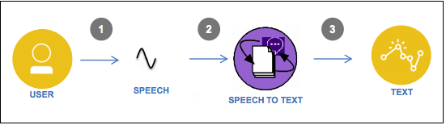
Speech to Text
What is it?
Automatically transcribe audio and voice from 7 spoken languages into text in real-time. Allows custom training as well.
How does it work?
Uses deep machine learning (e.g. LSTM, WaveNet, acoustic models) to set a world record at 5.5% error rate versus humans at 5.1% error rate.
Example Use Cases
Voice enabled applications
Smart Cars
Smart speakers
•
•
•
•
Source: http://www.redbooks.ibm.com/redbooks/pdfs/sg248388.pdf
youTube: https://www.youtube.com/watch?v=8q0DjDrCX5Y&t=2s
Case Study: http://www.zdnet.com/article/jefferson-health-patients-to-soon-ask-ibm-watson-clinical-questions/
Notes:
Use Cases
Brand Analytics
Measure the brand personality and compare/contrast with your customers to deliver an actionable recommendations
Market segmentation, Campaign Management, or Promotions
Develop a market segmentation which allows marketers to individualize its campaigns or promotions
Customer Care
Individualize customer care by providing personality traits to drive a 1:1 response
Matching, (Recruitment, University Admission, Love)
Apply individualized traits to match individuals to other individuals, jobs, universities, etc.Watson Personality Insights-Case Studies_v7.pptx
View Case Studies: Watson Personality Insights-Case Studies_v7.pptx

Slide 43
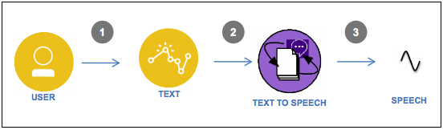
Text to Speech
What is it?
Converts written text in 7 languages into natural sounding human voice in a variety of languages and voices. Also allows custom models.
How does it work?
Uses deep machine learning algorithms.
Example Use Cases
Robots
Language Translation Earphones
Smart Cars
Talking Dinosaur Toys
•
•
•
•
Source: http://www.redbooks.ibm.com/redbooks/pdfs/sg248388.pdf
youTube: https://www.youtube.com/watch?v=ghbS-aTYw14
Case Study: http://newatlas.com/lingmo-translation-earpiece-one2one/50008/
Notes:
Use Cases
Brand Analytics
Measure the brand personality and compare/contrast with your customers to deliver an actionable recommendations
Market segmentation, Campaign Management, or Promotions
Develop a market segmentation which allows marketers to individualize its campaigns or promotions
Customer Care
Individualize customer care by providing personality traits to drive a 1:1 response
Matching, (Recruitment, University Admission, Love)
Apply individualized traits to match individuals to other individuals, jobs, universities, etc.Watson Personality Insights-Case Studies_v7.pptx
View Case Studies: Watson Personality Insights-Case Studies_v7.pptx

Slide 44
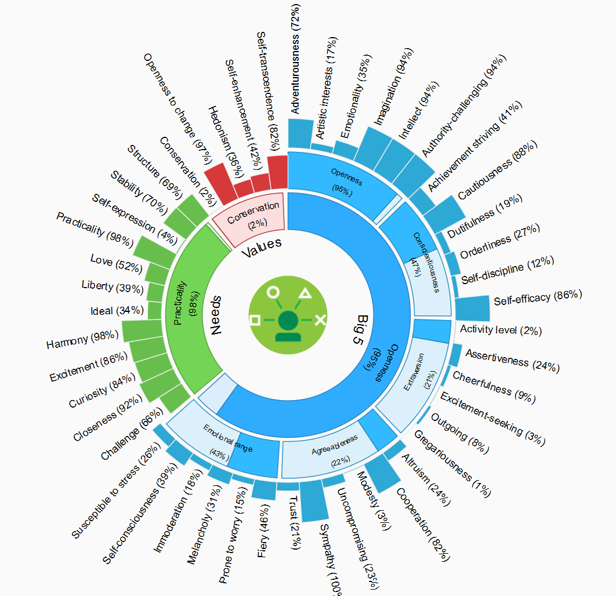
Personality Insights
What is it?
Enables deeper understanding of people's personality characteristics, needs, and values to help engage users on their own terms.
How does it work?
Extracts a set of personality and social traits based on the way a person communicates.
Example Use Cases
Hiring Processes
Personalized Marketing Campaigns
Sports Draft Picking
•
•
•
•
youTube: https://youtu.be/cJC8cxm_TCc?t=143
Case Study: http://motherboard.vice.com/read/toronto-raptors-nba-draft-day-ibm-watson
Notes:
Use Cases
Brand Analytics
Measure the brand personality and compare/contrast with your customers to deliver an actionable recommendations
Market segmentation, Campaign Management, or Promotions
Develop a market segmentation which allows marketers to individualize its campaigns or promotions
Customer Care
Individualize customer care by providing personality traits to drive a 1:1 response
Matching, (Recruitment, University Admission, Love)
Apply individualized traits to match individuals to other individuals, jobs, universities, etc.Watson Personality Insights-Case Studies_v7.pptx
View Case Studies: Watson Personality Insights-Case Studies_v7.pptx

Slide 45
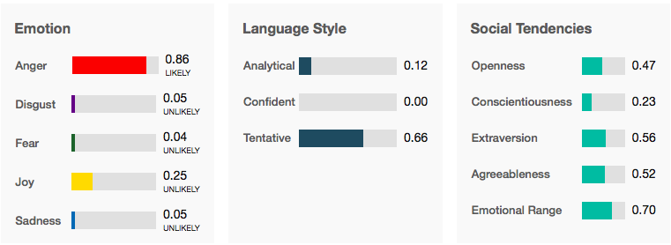
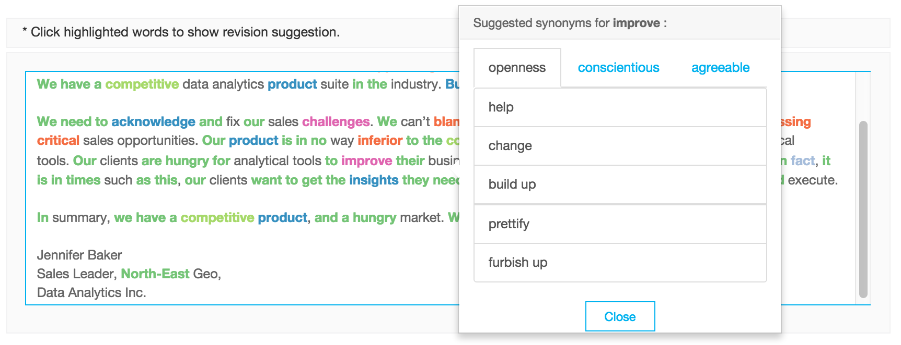
Tone Analyzer
What is it?
The Tone Analyzer service uses linguistic analysis to detect emotional tones, social propensities, and writing styles in written communication.
How does it work?
The frequency with which we use certain types of words can provide clues to personality, thinking style, social connections, and emotional states. Tone Analyzer builds on these foundations to infer one's tone from one's text.
Example Use Cases
Automated call center routing
Social Media Tone Checker
Automated Backlog Prioritization
youTube: https://www.youtube.com/watch?v=wUb--6FPBik
Case Study: https://www.youtube.com/watch?v=laMzhedGX-g
Notes:
Add link to bluemix page before submitting

Slide 46
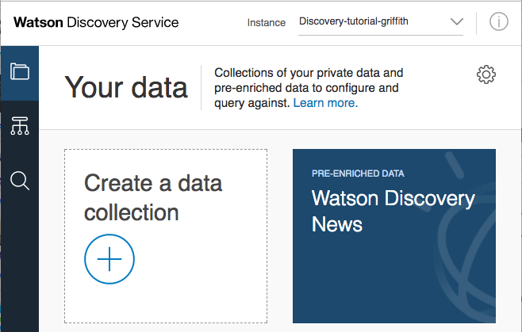
Discovery
What is it?
A cognitive search engine that allows you to uncover the insights in your ”dark data”.
How does it work?
Train your own domain model by which you can use natural language queries to find patterns and insights.
Example Use Cases
Analytics of Customer Reviews
Long-tail Chatbots
Cognitive Knowledge Base
youTube: https://www.youtube.com/watch?v=GFZ2IaTVkY8
Case Study: hthttps://mashable.com/2016/12/14/ibm-watson-als-research/

Slide 47
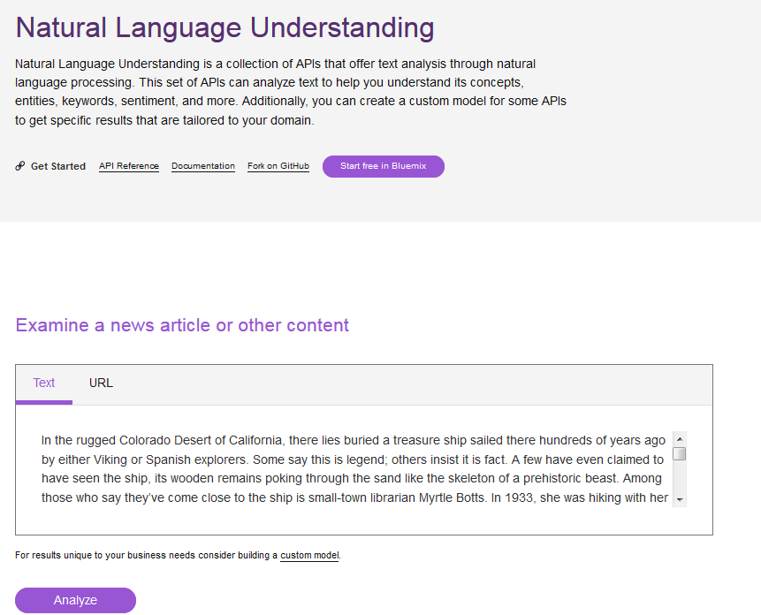
Natural Language Understanding
What is it?
NLU can analyze unstructured content to extract the concepts, the entities, the keywords, ontology, sentiment, emotion, semantic roles, and relationships. You can also train it for your domain specific needs.
How does it work?
Uses advanced natural language processing (NLP) capabilities to process unstructured text out-of-the box for 9 human languages.
Example Use Cases
Brand Mgmt
Content Recommendations
Advertising Optimizations
•
•
Case Study: http://www.adweek.com/digital/cond-nast-has-started-using-ibms-watson-find-influencers-brands-173243/
Notes:
https://natural-language-classifier-demo.mybluemix.net

Slide 48
Watson Knowledge Studio
What is it?
A cloud based tool for training Watson on domain specific terminology in a full lifecycle governance methodology.
How does it work?
Assigns a representative sample of documents that can be annotated by a team of SMEs for training Watson.
Example Use Cases
Automatically process insurance claims
Determine most common product issues
Case Study: https://www.ibm.com/watson/stories/woodside.html

Slide 49
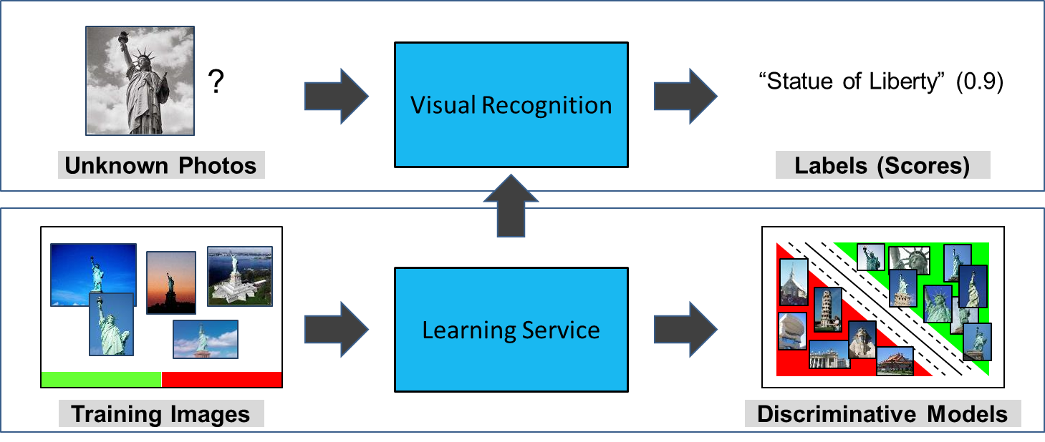
Visual Recognition
What is it?
Applies deep machine learning algorithms to classify images into custom categories.
How does it work?
Using Convolutional Neural Nets with millions of labeled images.
Example Use Cases
Visual Auditing of Manufacturing
Rapidly process claims using photos
Detect Melanoma from photos
•
youTube: https://www.youtube.com/watch?v=BWDfP_udMA0
Case Study: https://www-03.ibm.com/press/us/en/pressrelease/50688.wss

Slide 50
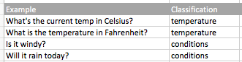

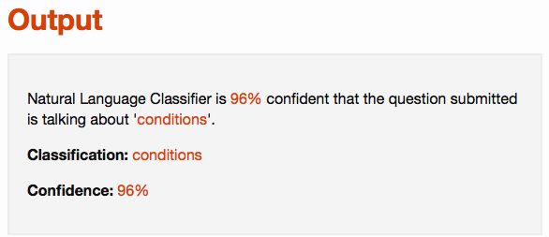
Natural Language Classifier
What is it?
Applies deep learning techniques to predict the classification of new text against the trained classification model.
How does it work?
It is “well-read” in Wikipedia enabling it to classify text it isn’t trained on.
Example Use Cases
SMS Text Classification
Automated email routing
Cognitive Retail
•
•
•
•
Notes:
https://natural-language-classifier-demo.mybluemix.net

Slide 51
Section 4.6 – Understand IBM Cloud Analytics Options
IBM Cloud Analytics Services
Spark
Hadoop
Streaming Analytics - https://cloud.ibm.com/docs/services/StreamingAnalytics?topic=StreamingAnalytics-about
What is IBM Analytics Engine - https://cloud.ibm.com/docs/services/AnalyticsEngine?topic=AnalyticsEngine-IAE-overview
What is DB2 Warehouse - https://cloud.ibm.com/docs/services/Db2whc?topic=Db2whc-about
What is IBM Cognos Dashboard Embedded - https://cloud.ibm.com/docs/services/cognos-dashboard-embedded?topic=cognos-dashboard-embedded-overview_of_cde
https://www.ibm.com/analytics/data-science

Slide 52
Section 4.7 – Understand IBM Cloud Database Options
Relational Databases
Document Based Databases
Key-Value Based Databases
Graph based databases
Managed Database choices
https://cloud.ibm.com/catalog?category=databases

Slide 53
Section 4.8 – Understand IBM Cloud Hyper Protect Crypto Services
What are IBM HyperProtect Crypto Services
Benefits of IBM HyperProtect Crypto Services
https://cloud.ibm.com/docs/services/hs-crypto?topic=hs-crypto-get-started

Slide 54
Section 4.9 – Understand IBM Cloud Hyper Protect DB as a Service (DBaaS)
What is IBM HyperProtect DBaaS
Benefits of IBM HyperProtect DBaaS
https://cloud.ibm.com/catalog/services/hyper-protect-dbaas-for-mongodb#about

Slide 55
Notices and disclaimers
Copyright © 2020 by International Business Machines Corporation (IBM). No part of this document may be reproduced or transmitted in any form without written permission from IBM.
U.S. Government Users Restricted Rights — use, duplication or disclosure restricted by GSA ADP Schedule Contract with IBM.
Information in these presentations (including information relating to products that have not yet been announced by IBM) has been reviewed for accuracy as of the date of initial publication and could include unintentional technical or typographical errors. IBM shall have no responsibility to update this information. This document is distributed “as is” without any warranty, either express or implied. In no event shall IBM be liable for any damage arising from the use of this information, including but not limited to, loss of data, business interruption, loss of profit or loss of opportunity. IBM products and services are warranted according to the terms and conditions of the agreements under which they are provided.
IBM products are manufactured from new parts or new and used parts. In some cases, a product may not be new and may have been previously installed. Regardless, our warranty terms apply.”
Any statements regarding IBM's future direction, intent or product plans are subject to change or withdrawal without notice.
Performance data contained herein was generally obtained in a controlled, isolated environments. Customer examples are presented as illustrations of how those customers have used IBM products and the results they may have achieved. Actual performance, cost, savings or other results in other operating environments may vary.
References in this document to IBM products, programs, or services does not imply that IBM intends to make such products, programs or services available in all countries in which IBM operates or does business.
Workshops, sessions and associated materials may have been prepared by independent session speakers, and do not necessarily reflect the views of IBM. All materials and discussions are provided for informational purposes only, and are neither intended to, nor shall constitute legal or other guidance or advice to any individual participant or their specific situation.
It is the customer’s responsibility to insure its own compliance with legal requirements and to obtain advice of competent legal counsel as to the identification and interpretation of any relevant laws and regulatory requirements that may affect the customer’s business and any actions the customer may need to take to comply with such laws. IBM does not provide legal advice or represent or warrant that its services or products will ensure that the customer is in compliance with any law.

Slide 56
Notices and disclaimers continued
Information concerning non-IBM products was obtained from the suppliers of those products, their published announcements or other publicly available sources. IBM has not tested those products in connection with this publication and cannot confirm the accuracy of performance, compatibility or any other claims related to non-IBM products. Questions on the capabilities of non-IBM products should be addressed to the suppliers of those products. IBM does not warrant the quality of any third-party products, or the ability of any such third-party products to interoperate with IBM’s products. IBM expressly disclaims all warranties, expressed or implied, including but not limited to, the implied warranties of merchantability and fitness for a particular, purpose.
The provision of the information contained herein is not intended to, and does not, grant any right or license under any IBM patents, copyrights, trademarks or other intellectual property right.
IBM, the IBM logo, ibm.com, Aspera®, Bluemix, Blueworks Live, CICS, Clearcase, Cognos®, DOORS®, Emptoris®, Enterprise Document Management System™, FASP®, FileNet®, Global Business Services®, Global Technology Services®, IBM ExperienceOne™, IBM SmartCloud®, IBM Social Business®, Information on Demand, ILOG, Maximo®, MQIntegrator®, MQSeries®, Netcool®, OMEGAMON, OpenPower, PureAnalytics™, PureApplication®, pureCluster™, PureCoverage®, PureData®, PureExperience®, PureFlex®, pureQuery®, pureScale®, PureSystems®, QRadar®, Rational®, Rhapsody®, Smarter Commerce®, SoDA, SPSS, Sterling Commerce®, StoredIQ, Tealeaf®, Tivoli® Trusteer®, Unica®, urban{code}®, Watson, WebSphere®, Worklight®, X-Force® and System z® Z/OS, are trademarks of International Business Machines Corporation, registered in many jurisdictions worldwide. Other product and service names might be trademarks of IBM or other companies. A current list of IBM trademarks is available on the Web at "Copyright and trademark information" at: www.ibm.com/legal/copytrade.shtml.

